Slide 1
Land cover classfication
Using deep learning

Slide 2
Group member Information
Leela prasad kalla - 700747785
Mohith duggirala - 700756712
Sai kiran palakurla - 700757133
Sushmitha chelledi - 700744167

Slide 3
Role/Responsibilities and Contribution in project
Name | Role | Responsibility | Contribution
leelaprasad | Project Coordinator | Responsible coordinating team meetings | Setting timelines Coordination and communication
Leelaprasad and Mohith | Model Trainer/Developer | Responsible for designing the architecture ResNet, DenseNet, and attention mechanism | Deep learning model implementation
Sushmita and Sai kiran | Analyst | Responsible for evaluating the performance of the trained models | Performance analysis
Sushmita | Technical Writer | Responsible for documenting report | Report Drafting

Slide 4
Motivation
The project is motivated by three key factors:
1. Hydrological regulation:
Land cover, like forests, grasslands, or cities, influences how water moves on Earth. It affects evaporation (water turning into vapor), transpiration (plants releasing water vapor), infiltration (water soaking into the ground), and runoff (water flowing over the surface). This information is important to stakeholders and sectors. For example, Disaster management agencies rely on this information to assess natural disasters, such as floods, landslides, and droughts.
2. Understanding carbon emissions is crucial for addressing climate change and advancing sustainable development, as activities such as deforestation, urbanization, and agricultural expansion can release stored carbon into the atmosphere. By examining land cover types, valuable insights into carbon emissions can be obtained.
3. Land cover provides insights into ecosystems, including the availability of food and shelter for humans.

Slide 5
Objectives
The main objectives of this project are:
1. Comparative Analysis of Models: Conduct a comprehensive comparative analysis of different deep learning models, including ResNet, DenseNet, and attention mechanism. Evaluate their performance in terms of accuracy, precision, recall, and F1 score.
2. Utilization of Transfer Learning: Implementing transfer learning techniques to fine-tune them to the specific requirements of the study.
3. Performance Evaluation: Assess the performance of ResNet, DenseNet, and attention mechanism models quantitatively and qualitatively. Analyze metrics such as accuracy, precision, recall, and F1-score to determine the effectiveness of each model variant
results.

Slide 6
Related work
This study proposes urban land cover classification using features from segments' objects, deep learning, and spatial associations. Deep features extracted from segments are obtained through a convolutional neural network and spatial association features are captured using a graph convolutional neural network. Classification is performed using the random forest algorithm. Results show that pixel-based methods are outperformed by segment-based methods [1].
This paper proposes the three different CNN architectures on high-resolution satellite images for Land Cover and Land Use classification.The three architectures include fully trained model, fine tuned model and pre-trained model. The pre-trained models used in this task are AlexNet and GoogLeNet. The experiment analysis is performed on two kinds of datasets one is Brazilian Coffee Scenes and the other one is UC Merced Land Use. The experimental analysis shows that pre-trained models outperformed the remaining models [2].
The previous models worked on classification of land cover and predicting the land usage. In this paper a novel approach is proposed to detect the changes of land cover. To implement this NAIP ( National Agriculture Imagery Program) dataset is collected. The methodology is that between the two timestamps changes are quantified. To measure the changes the spatial transitions and area affected are calculated [3].

Slide 7
Problem Statement
Land cover refers to the physical coverage of the Earth's surface, such as snow, water bodies, and forests. Additionally, it extends to the classification of how the land is utilized, including categories such as wildlife habitats, urban areas, and agricultural zones. In the agricultural sector, a prevalent use case involves evaluating land quality, examining soil nutrient characteristics, and determining land availability. The significance of automatic land cover classification and area calculation has grown, driven by its applications across various sectors.
Despite the presence of class balance within the accessible dataset, current systems encounter difficulties in capturing complex patterns associated with different land cover types. Furthermore, real-time applications face challenges due to the temporal dynamics of land covers, including changes in weather conditions. Another issue is that the models exhibit limitations in the generalisation of how different areas interpret and define land cover types in various regions.

Slide 8
Proposed Solution
We propose a comprehensive comparative analysis of models, RensNet and DenseNet, alongside attention mechanism models such as transformers. Our approach involves implementing these models through the utilisation of transfer learning techniques, allowing for the fine-tuning of the models to the specific requirements of our study.

Slide 9
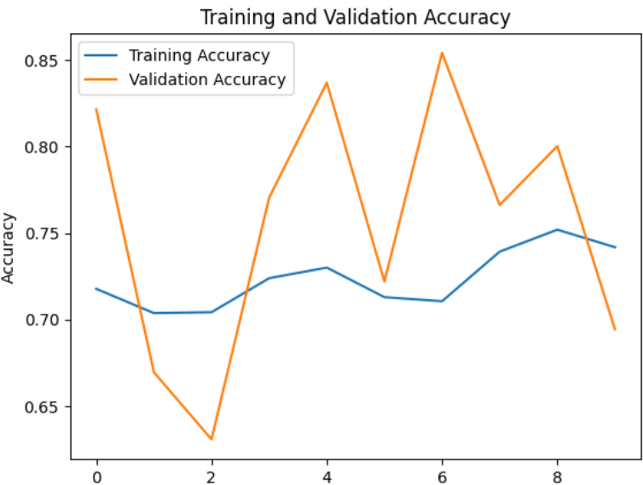
Results/Simulations
Figure.1.Represents accuracy plot of the model. The model achieved 85 percent validation accuracy and 75 percent training accuracy
Figure.1. ResNet50 model performance

Slide 10
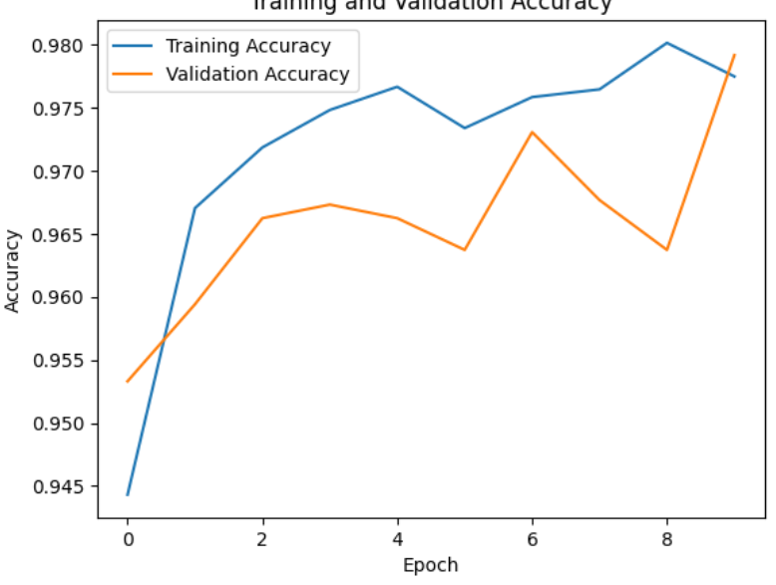
Results/Simulations
Figure.2.Represents accuracy plot of the DenseNet model. The model achieved 97 percent validation accuracy and 98 percent training accuracy
Figure.2. DenseNet model performance

Slide 11
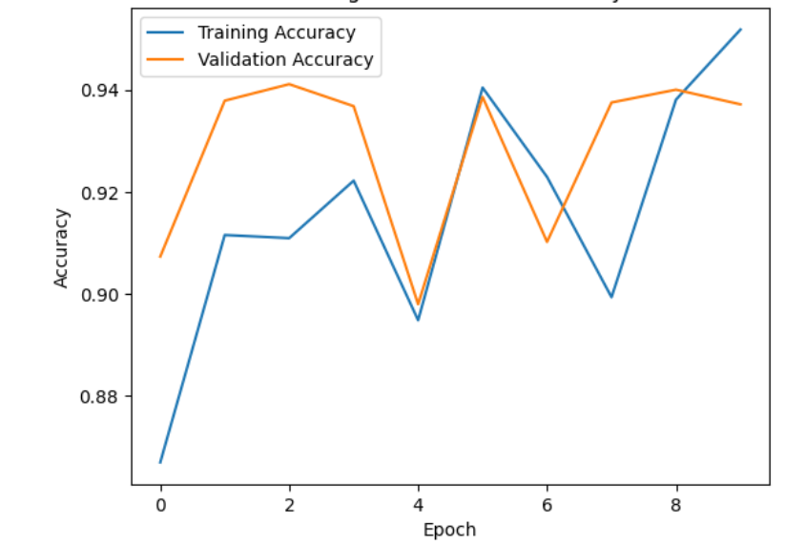
Results/Simulations
Figure.3.Represents accuracy plot of the DenseNet model with attention mechanism. The model achieved 93 percent validation accuracy and 95 percent training accuracy
Figure.3. DenseNet with attention model performance

Slide 12
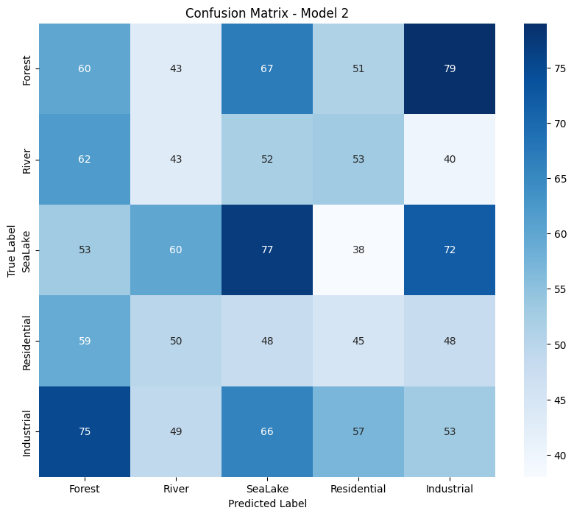
Results/Simulations
Figure.4.Represents Confusion matrix plot of the DenseNet model.
Figure.4. Confusion matrix for DenseNet model

Slide 13
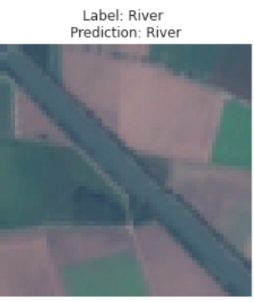
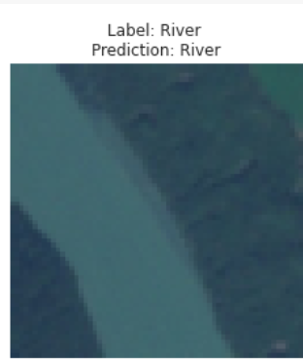
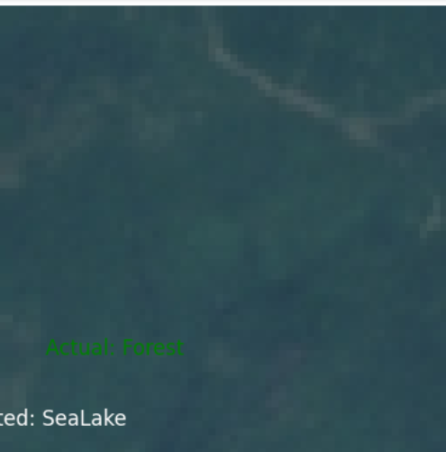
Results/Simulations
Figure.3.Sample predictions

Slide 14
References
[1] Alynne Almeida Affonso, Silvia Sayuri Mandai, Tatiana Pineda Portella, Jose Alberto Quintanilha, and Carlos Henrique ´ Grohmann. Tracking land use and land cover changes in the volta grande do xingu(parA - brazil) between 2000 and 2017 ´ through three pixel-based classification methods. In IGARSS 2022 - 2022 IEEE International Geoscience and Remote Sensing Symposium, pages 5630–5633, 2022.
[2] Rakesh Kumar Appala and Vidhya Lakshmi Sivakumar. An evaluation of performance of change detection of land use/land cover in hyderabad city using artificial neural network and mahalanobis classification to improve accuracy. In 2023 International Conference on Artificial Intelligence and Knowledge Discovery in Concurrent Engineering (ICECONF), pages 1–6, 2023.
[3] Rajeswari Harini Bikkasani, Dhanya M, and Veena S V. Analysis of long-term changes for land use and land cover using machine learning: A case study. In 2023 2nd International Conference on Applied Artificial Intelligence and Computing (ICAAIC), pages 542–546, 2023.

